Slide 1
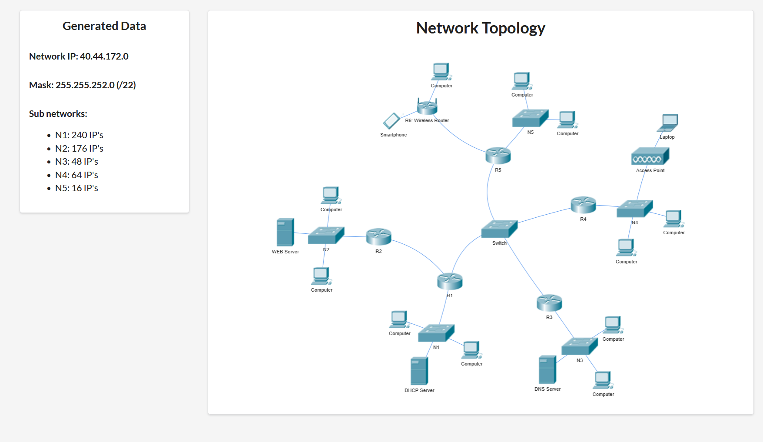

Slide 2
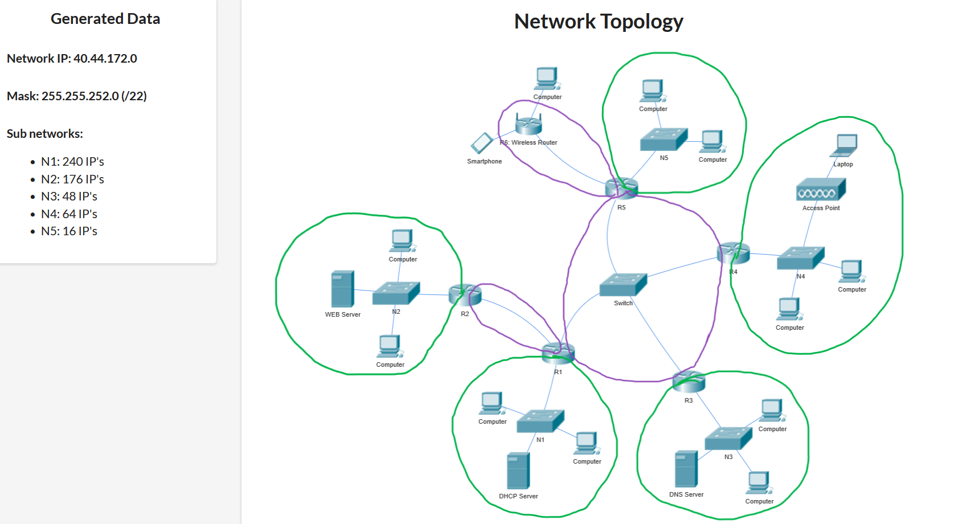
x = 32 – 22 = 10 zeros => 2^10 = 1024 IP addresses
What other networks do we need?
N1345: 4 IP’s
N12: 2 IP’s
N5w: 2 IP’s
NA = 40.44.172.0 AND 255.255.252.0= 40.44.172.0
BA = 40.44.172.0 OR NOT(255.255.252.0) = 40.44.175.255

Slide 3
/22 => 1024 IP addresses
n devices (IP) + 1 router + 1 NA + 1 BA => n + 3 IP’s
N1: 240 + 3 = 243 < 256 = 2 ^ 8, 8 zeros, 32 – 8 = 24 ones => mask /24
N2: 176 + 3 = 179 < 256 = 2 ^ 8, 8 zeros, 32 – 8 = 24 ones => mask /24
N3: 48 + 3 = 51 < 64 = 2 ^ 6, 6 zeros, 32 – 6 = 26 ones => mask /26
N4: 64 + 3 = 67 < 128 = 2 ^ 7, 7 zeros, 32 – 7 = 25 ones => mask /25
N5: 16 + 3 = 19 < 32 = 2 ^ 5, 5 zeros, 32 – 5 = 27 ones => mask /27
N1345: 4 + 2 = 6 < 8 = 2 ^ 3, 3 zeros, 32 – 3 = 29 ones => mask /29
N12: 2 + 2 = 4 < 4 = 2 ^ 2, 2 zeros, 32 – 2 = 30 ones => mask /30
N5w: 2 + 2 = 4 < 4 = 2 ^ 2, 2 zeros, 32 – 2 = 30 ones => mask /30
Total:
256 + 256 + 64 + 128 + 32 + 8 + 4 + 4 = 752 needed < 1024 provided = 2 ^ 10
1024 – 752 = 272 available IP addresses

Slide 4
Recursive network split using a binary tree
/22 1024
/23 512 512
/24 256 256 256 256
/25 128 128
/26 64 64
/27 32 32
/28 16 16
/29 8 8
/30 4 4
N1 = 256, N2 = 256, N3 = 64, N4 = 128, N5 = 32, N1345 = 8, N12 = 4, N5w = 4

Slide 5
Recursive network split using intervals
40.44.172.0 /22 => 1024 IP addresses
[0…………………………………………………………………….……….…………………………………….1023]
[0…………………………511][512……..……………………………………….……………………....……….1023]
[0…255][256…511][512……..………......…………………………………………………………...767][768…1023]
[0…255][256…511][512...639][640......…………………..……………………..……………………767][768…1023]
[0…255][256…511][512...639][640…703][704……....……………………………………...………767][768…1023]
[0…255][256…511][512…639][640…703][704…735][736.…………………………...…………...767][768…1023]
[0…255][256…511][512…639][640…703][704…735][736……………………….….…751][752...767][768…1023]
[0…255][256…511][512…639][640…703][704…735][736…743][744……………..…751][752…767][768…1023]
[0…255][256…511][512…639][640…703][704…735][736…743][744…747][748...…751][752…767][768…1023]
N1 N2 N4 N3 N5 N1345 N12 N5w
NA and BA

Slide 6
Enumerating the networks
[40.44.172.0………. 40.44.175.255] => 1024 IP addresses
N1 = [40.44.172.0 … 40.44.172.255] NM = /24 R1 = .1 S1dhcp = .2
N2 = [40.44.173.0 … 40.44.173.255] NM = /24 R2 = .1 S2web = .2
N4 = [40.44.174.0 … 40.44.174.127] NM = /25 R4 = .1
N3 = [40.44.174.128 … 40.44.174.191] NM = /26 R3 = .129 S3dns = .130
N5 = [40.44.174.192 … 40.44.174.223] NM = /27 R5 = .193
N1345 = [40.44.174.224…40.44.174.231] NM = /29 R1 = .225 R3 = .226 R4 = .227 R5 = .228
N12 = [40.44.174.232…40.44.174.235] NM = /30 R1 = .233 R2 = .234
N5w = [40.44.174.236…40.44.174.239] NM = /30 R5 = .237 Rw = .238
Available addresses: [40.44.174.240…40.44.175.255] => 272 IP addresses

